Slide 1
Section 106 of the National Historic Preservation Act
Amy Klein
Regulatory Program Manager
Headquarters

Slide 2
National Historic Preservation Act (NHPA)
Section 106
Prior to the issuance of any permit, the Federal agency (Corps) shall take into account the effect of the undertaking (permit) on any historic property.
The Federal agency shall afford the Advisory Council on Historic Preservation a reasonable opportunity to comment on the undertaking and its effect(s).
Section 101(d)(6)(B)
The Federal agency shall consult with any Indian tribe or Native Hawaiian organization that attaches religious and cultural significance to properties.
Section 101(d)(6)(A)
Properties of traditional religious and cultural importance to an Indian tribe or Native Hawaiian organization may be determined to be historic properties.

Slide 3
Historic Property
A historic property is a property which as historical importance to any person or group. This term includes the types of districts, sites, buildings, structures, or objects eligible for inclusion, but not necessarily listed, on the National Register
- 33 CFR 325 Appendix C Part 1.(b)
It can be a place, a structure, the location of an event, an association with historic people, a Traditional Cultural Property or Landscape, lots of things…
Eligibility determinations must follow a detailed process that can involve multiple parties.

Slide 4
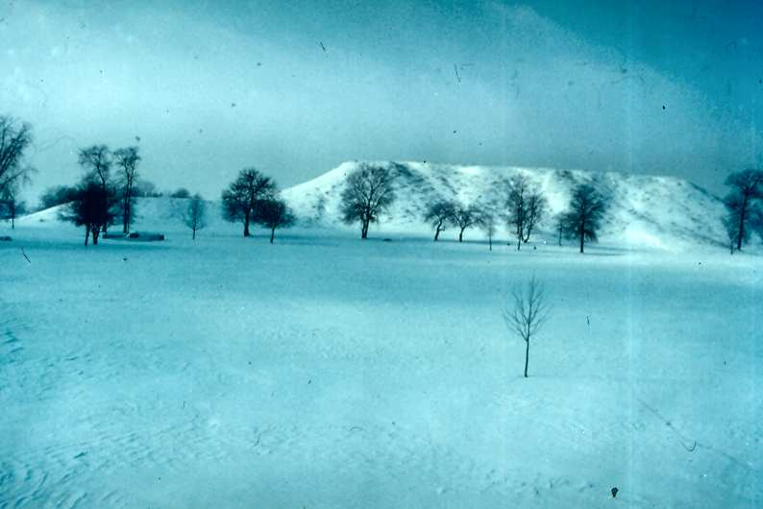
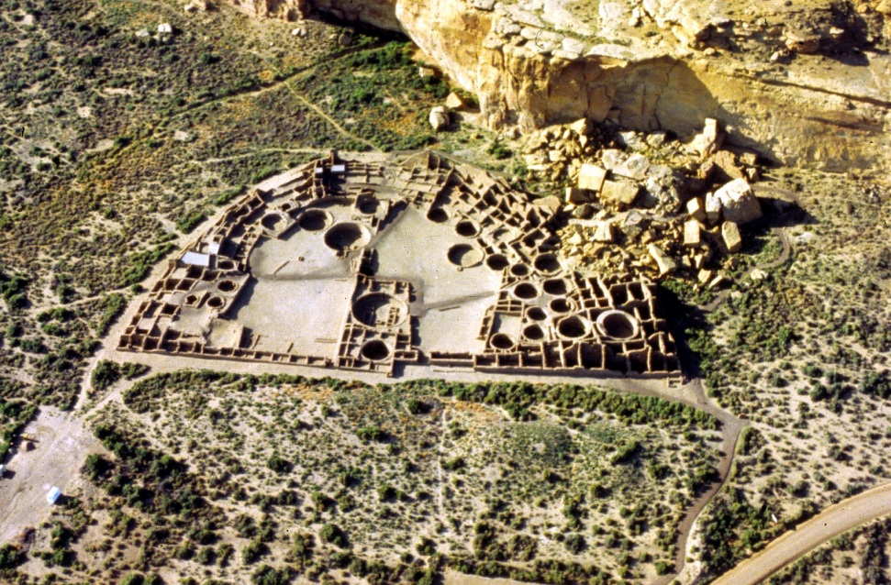
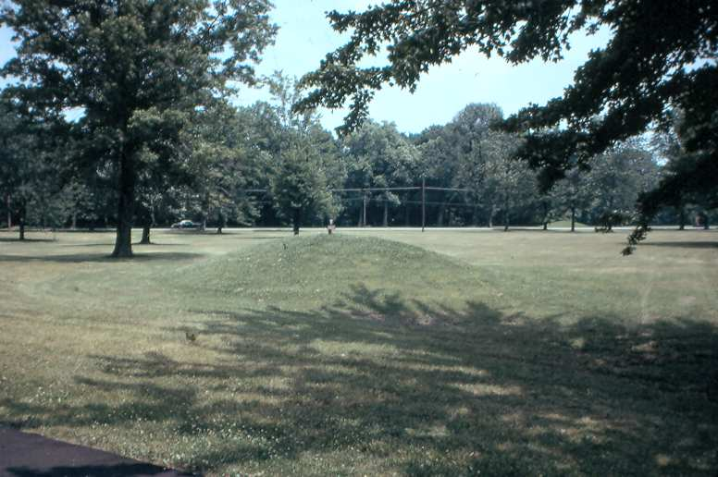
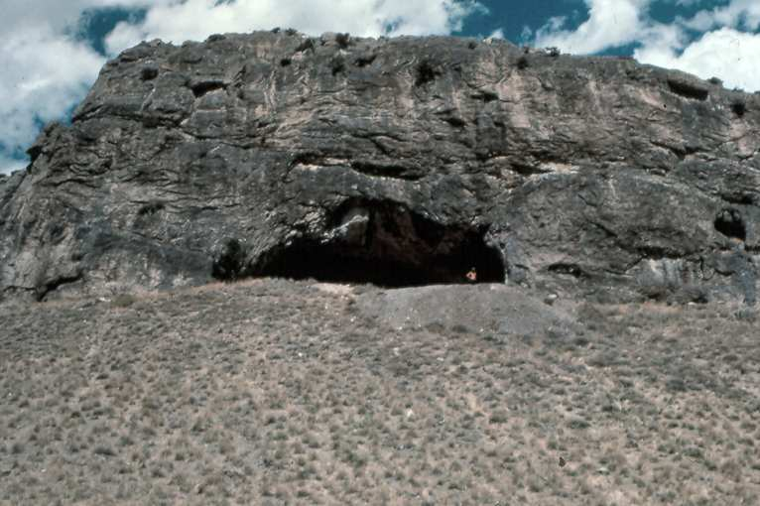
Some Properties are Obvious & Easy to Identify

Slide 5
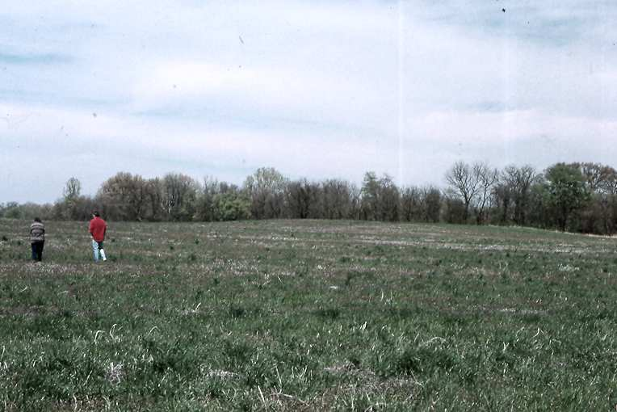
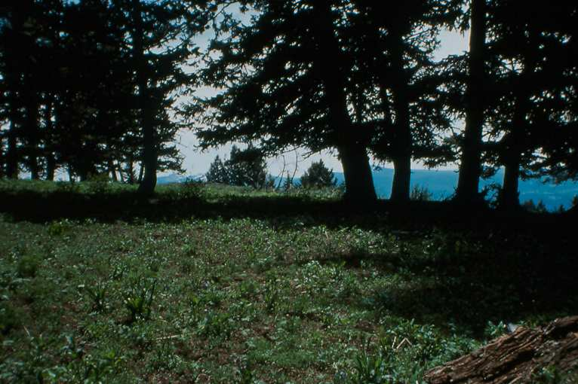
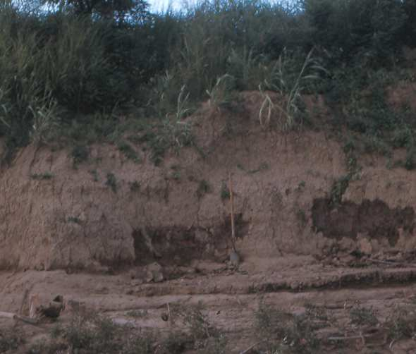
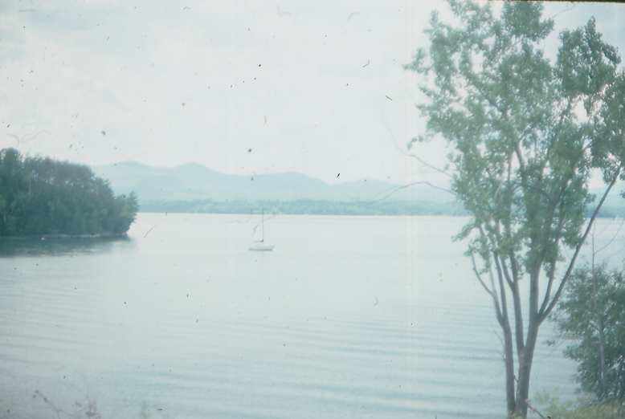
Some archeological sites are not so obvious

Slide 6
Stakeholders in the Regulatory 106 Process
The Corps
SHPO/THPO
ACHP (in some situations, not all…)
Tribes
Consulting Parties
Applicants

Slide 7
Critical Regulatory Program Section 106 Documents
33 CFR 325 Appendix C for permit area, links to WoUS, DE decision making
33 CFR 325 Appendix B for NEPA scope of analysis
Interim Guidance 2005 & 2007 for integrated definitions
36 CFR 800 for all definitions and links to the Federal 106 process.
Related Scope Docs (1991 Scope Guidance, 1987 CEQ opinion, etc.)

Slide 8
“Undertaking” - USACE Regulatory Context
33 CFR 325 (Appendix C 1(f))
The term ``undertaking'‘ means the work, structure or discharge that requires a Department of the Army permit pursuant to the Corps regulations at 33 CFR 320-334
36 CFR 800.16(y)
Undertaking means a project, activity, or program funded in whole or in part under the direct or indirect jurisdiction of a Federal agency, including those carried out by or on behalf of a Federal agency; those carried out with Federal financial assistance and those requiring a Federal permit, license or approval
Take Away: The Corps determines the undertaking. SHPO/THPO/ACHP may be consulted, but it is the Corps determination

Slide 9
CW/800 APE vs Regulatory Permit Area
36 CFR 800.16
(d) Area of potential effects means the geographic area or areas within which an undertaking may directly or indirectly cause alterations in the character or use of historic properties, if any such properties exist. The area of potential effects is influenced by the scale and nature of an undertaking and may be different for different kinds of effects caused by the undertaking.
33 CFR 325 (Appendix C 1(g))
Permit area (1) The term ``permit area'' as used in this appendix means those areas comprising the waters of the United States that will be directly affected by the proposed work or structures AND UPLANDS directly affected as a result of authorizing the work or structures. The following three tests must all be satisfied for an activity undertaken outside the waters of the United States to be included within the ``permit area'‘…
Take Away: The agency should match the scale of the undertaking to the scope of the Federal involvement

Slide 10
Permit Area
Stream road crossing
Permit Area
Wetland road crossing

Slide 11
Permit Area - Three Tests in Appendix C
33 CFR 325 Appendix C Part 1(g)
(i)…activity would not occur but for the authorization of the work or structures within WOUS (‘but for’ clause MUST not be used in isolation!)
***Note “but for” appears nowhere else (some will assert it drives NEPA and ESA compliance but it does not)***
(ii)…activity must be integrally related to the work or structures to be authorized within WOUS. OR...the work or structures authorized must be essential to the completeness of the overall project and program.
(iii) Such activity must be directly associated (first order impact) with the work or structures to be authorized.

Slide 12
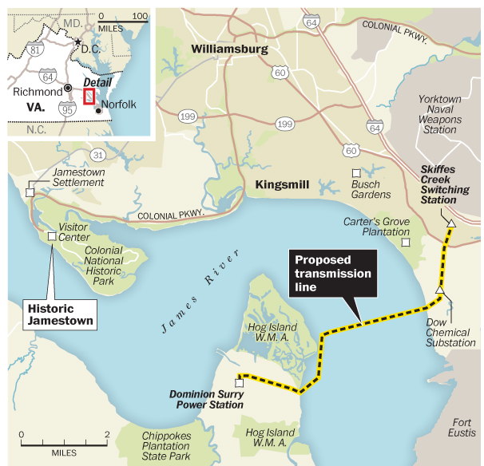
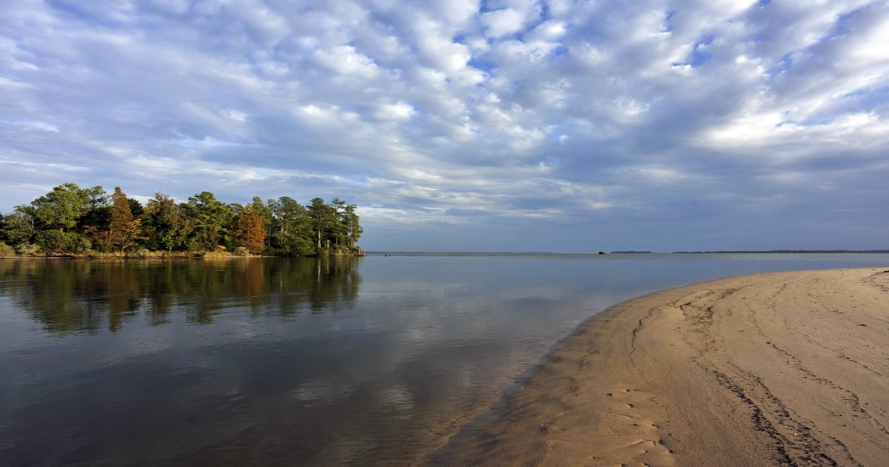
Transmission Lines and View Sheds
---Vistas Capt John Smith and first English settlers saw in 1607
---Transmission line needed to prevent rolling blackouts – Navy supports project
---Disagreement to what extent the line would really impact such vistas since other development is in the viewshed. EIS or EA?
Notes:
But James City County and historic preservationists are fighting the proposal, contending the new line will destroy the vistas that Capt. John Smith and the first English settlers saw when they sailed the James in early 1607.
They assert that the towers will damage the view from the Colonial Parkway, the tip of Jamestown Island and Carter's Grove Plantation. They say Dominion hasn't fully explored alternatives, such as other river crossings.

Slide 13
Traditional Cultural Properties and Traditional Cultural Landscapes Pala Indian Reservation, San Luis Reyes River, San Diego County, California
Notes:
Gregory Canyon, located in San Diego County, California, is an example of a Regulatory project with very broad potential impacts to (among other resources) historic properties. The mountain to the right is considered to be a Traditional Cultural Property by the Pala Mission Indians. The valley within this photo is a proposed landfill for San Diego County and would deposit almost 200’ of trash against the mountain. A large boulder, visible left-center, is a sacred site used by the Pala tribe. Direct impacts to the waters of the US (WOUS) are based on several hundred feet of intermittent stream. Potential impacts to water quality on the San Luis Reyes River, as well as historic properties and visual impact, create a very broad scope of review for the project, resulting in development of an EIS.

Slide 14
Types of Mitigation
Avoidance and Minimization – can the project footprint/impact area be modified to avoid/minimize impacts to historic properties?
“Compensation” – If a resource must be destroyed, there may be ways to mitigate, such as photographs, documentation, etc.
National Historic Preservation Act does not REQUIRE that resources be protected but permitting the destruction of resources must be very carefully evaluated.

Slide 15
Summary of Common Issues
Some parties, including some SHPOs, Tribes, ACHP staff, and others assert Appendix C is illegal - of course it is not! It is a valid regulation and failing to abide by it and subsequent guidance would be illegal.
Many parties regularly disagree with the Corps’ definition of Federal undertaking within the context of the Regulatory Program. They want us to regulate more than we do.
Many parties want the Corps to expand the permit area to “area of potential effect” based on a larger undertaking. We cannot do this!
Some parties may try to convince you that you do not have the authority to make a decision unless there is “consensus.”

Slide 16
Critical Takeaway for DEs:
A. Determine scope of analysis/permit area for your project
B. Identify historic properties in the permit area (or the reason no identification is necessary)
C. Determine eligibility of historic properties (read this again, it is a critical step)
D. Determine effects to NRHP eligible historic properties
E. Determine avoidance, protection, or mitigation of affected NRHP eligible historic properties
F. Conclude the process; use agreement documents and conditions in the permit to seal the deal on site protection and adverse effects.
G. In the event there are irreconcilable differences and every effort to resolve them has been made, and document, you still have the power to move forward and make a permit decision.

